Slide 1




Jarvis 2026 Q&A
Jarvis Team
2026

Slide 2




Q1: Jarvis Role
Jarvis Identity
Siraya vs Jarvis
Jarvis operates as an independent Vietnamese R&D company, focusing on pure IT R&D for multiple group companies.
Siraya: business/sales agency, market expansion. Projects shift to outsourced maintenance or Siraya R&D team.

Slide 3




Q2: Future Plans
Team Growth
New Projects
Financial Goals
8 -> 15
3 New
57.8B
Team to grow from 8 to 15 by 2026-end, with Tech Leads added quarterly.
Launch new projects: TOMO AI HR (Q2), Sky-Net GC (Q3), Team R&D (Q3).
Achieve 57.8B VND revenue and reach break-even point by Q2 2027.

Slide 4
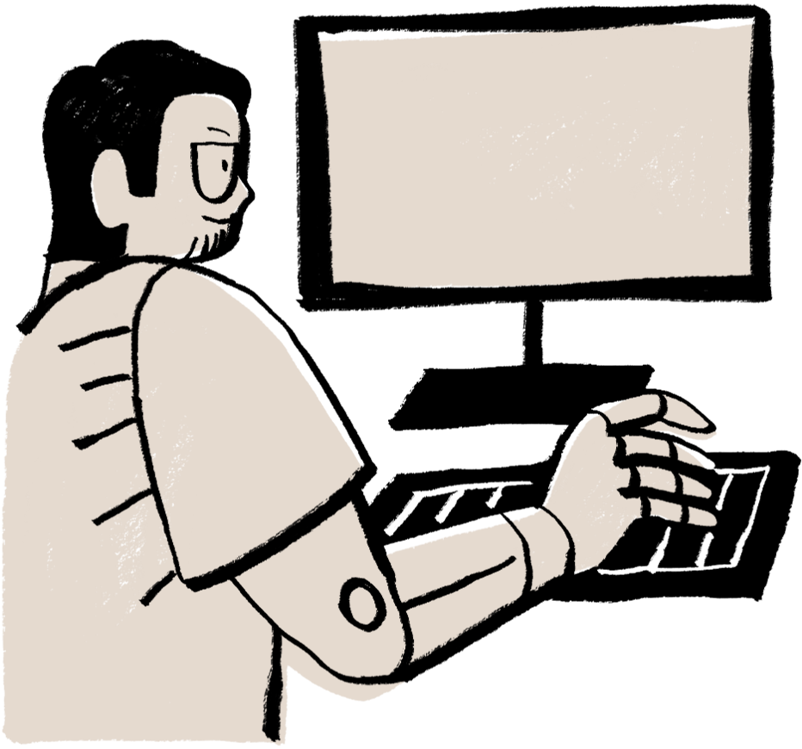
Hierarchy
Tech Lead reports to Ryan. Oversees Dev Team. Luan (Siraya/Client) is requirements & tech liaison.

Slide 5

Q4: Communication
Monthly Meeting
Annual Plan
1
Tech Leads meet with Ryan to discuss progress, challenges, and strategic alignment.
2
Ryan presents the next year's strategic plan and key objectives at year-end.
Cross-Border
Ad Hoc Needs
3
Three cross-border exchange meetings are scheduled annually to foster collaboration.
4
Admin coordinates additional meetings as needed to reach consensus on urgent matters.

Slide 6





Q5: Talent Move
Employee Choice
Employees may join Siraya; it's a new hire, not an internal transfer.
Transition Steps
Requires one month notice and complete handover of all responsibilities.
Accountability
Employees are accountable for results of their mobility decisions.

Slide 7




Q6: Tech Dev
AI Development
Vibe Coding (Cursor/Copilot) & Prompt Engineering training.
Code Quality
AI Code Review and robust automated testing implementation.
Dev Standards
Adherence to Git Flow and CI/CD industry standards.
Self-Directed R&D
Lead Q3 Team R&D project for Vietnam market.

Slide 8
Q6: Intl Dev
Global Exchange
Intl. Projects
1
Participate in three planned cross-border in-person exchange programs annually.
2
Engage in cross-border projects like TOMO AI HR and Sky-Net GC for global exposure.
Skill Enhancement
Leadership Paths
3
Access communication training utilizing AI tools and language development courses.
4
Team growth 8 to 15 fosters more collaboration and leadership opportunities.

Slide 9





Jarvis vs Siraya
Company Stage
Jarvis is a dynamic startup; Siraya is mature (approx. 5 years).
Core Focus
Jarvis is technology/R&D driven, Siraya is primarily business/market driven.
Management Style
Jarvis boasts flexible, flat management; Siraya has more institutionalized processes.
Key Advantage
Jarvis's strength is R&D capability; Siraya's is extensive market resources.

Slide 10



Summary
Jarvis is an independent R&D company; team growing to 15. Tech Lead reports to Ryan. Clear communication is key. Career growth through AI training & international projects. Jarvis's culture differs from Siraya. Your future is in your hands.

